Slide 1
Bellabeat Case Study for the Google Data Analytics Certificate
Annette Ricci
10/23/2023

Slide 2
Agenda
Give a description of the project
Describe the data sources
Summarize data cleaning process
Summarize data analysis process
Recommendations for marketing strategy

Slide 3
Background
Stakeholders:
Urška Sršen: Bellabeat’s cofounder and Chief Creative Officer
Sando Mur: Mathematician and Bellabeat’s cofounder; key member of the Bellabeat executive team
Bellabeat marketing analytics team: A team of data analysts responsible for collecting, analyzing, and reporting data that helps guide Bellabeat’s marketing strategy
Business Task:
Sršen asks you to analyze non-Bellabeat smart device usage data in order to gain insight into how consumers use other smart devices. She then wants you to select one Bellabeat product to apply these insights to.

Slide 4
Business Questions to be Answered:
What are some trends in the fitness tracker data?
How can these trends inform marketing strategy for Bellabeat products?

Slide 5
Data sources:
FitBit Fitness Tracker Data
Link: https://www.kaggle.com/datasets/arashnic/fitbit
Author: MÖBIUS
Year: 2016
Licensing: Creative Commons public domain
Eligible Fitbit users consented to the submission of personal tracker data for a 31-day period.

Slide 6
Type of data included:
Daily and hourly calories burned
Daily and hourly intensity of activities
Daily and hourly steps taken
Heartrate measured in 5 second increments
Daily sleep time in minutes
Daily weight log

Slide 7
Data Cleaning and Preparation Process
Using dplyr::n_distinct() showed there were no duplicate rows in the daily_activity table
Using the sum() function showed there were no unnecessary white spaces to be trimmed
The variable ActivityDate was recast from a “character” type to an mdy “date” type
The variable Id was recast from a “numeric” type to a “character” type
Full data cleaning log available: fitbit_cleaning_log.pdf

Slide 8
Exploratory Analysis
Initial exploration of the data revealed the following:
33 participants logged daily activity data
24 participants logged sleep data
8 participants logged weight data

Slide 9
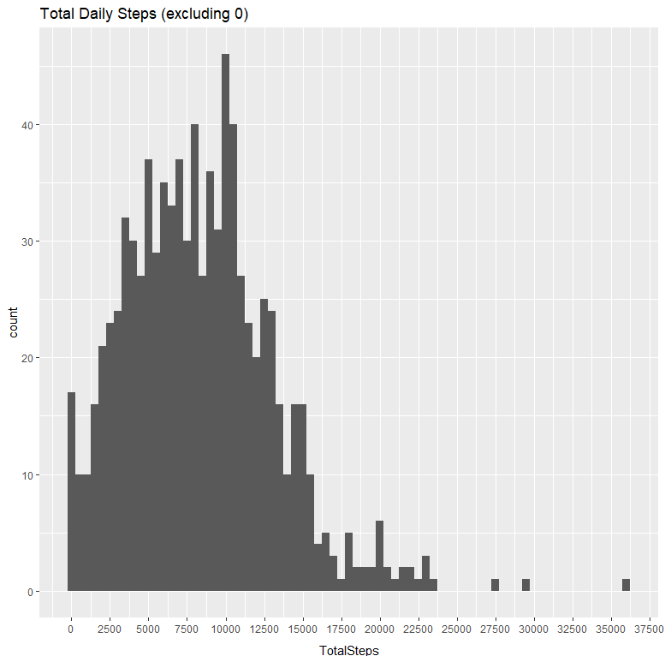
Daily Activity Analysis
The average participant took about 8,000 steps per day
Most fell between about 2,000 and 13,000 steps per day

Slide 10
Activity Intensity Analysis
The Fitbit measures activity intensity by a metric called MET, or the metabolic equivalent of a task.
Most minutes logged were sedentary
Besides sleep, Lightly Active was 2nd most common

Slide 11
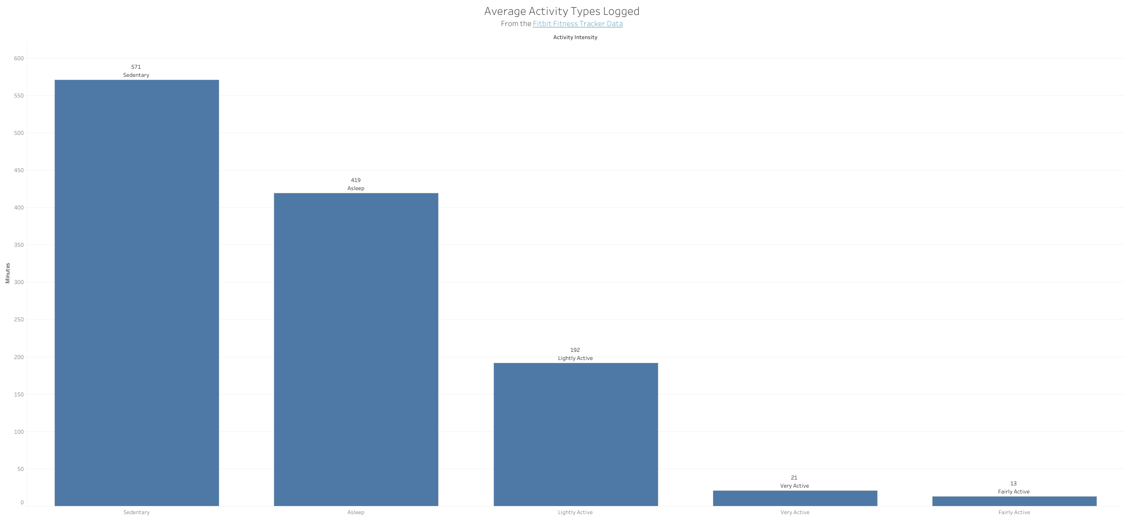
Activity Intensity Average Minutes

Slide 12
What percentage of participants used the following features?
100%
72%
8%

Slide 13
Recommendations
Focus marketing efforts on a more casual user type, perhaps highlighting Bellabeat products’ user-friendliness and showing various activity types in ads, including walking.

Slide 14
Recommendations
Collect survey data on sleep tracking feature to see what could be implemented to make it more useful.

Slide 15
Recommendations
At this time, don’t focus as much on the weight tracking feature since it doesn’t seem to be very popular.

Slide 16
Summary
Most people wearing fitness trackers use them for tracking sedentary or lightly active activities. There is some room for growth in terms of sleep tracking features. Moving forward, Bellabeat should focus marketing on accessibility for more casual users who are looking to keep track of overall health and wellness.

Slide 17
Thank you
Annette Ricci​
annette.ricci27@gmail.com
www.contoso.com

